Slide 1
Identify qualitycustomer using machine learning
Jiss Lawrence
Ullas Joseph

Slide 2
Contents
Challenges- insurance industry
Need analysis
Machine learning Implementation

Slide 3
Challenges
Intangible Product
Life insurance, General Insurance and health Insurance.
Need analysis
Right product
Identify the customer
Quality of the customer
Convertible and Quality leads from the large data from the market.

Slide 4
Solution by Machine learning
Identifying the purchasing behavior of the customer from the market by using basic general information.
Our data is about amount spent by the customer.

Slide 5
Variables
Age
Gender
Own home
Marital status
Location
Salary
Children
History
Catalogs
Amount spent
Customer ID

Slide 6
Logistic Regression Approach
identify customer id's who are considered “Amount spending” above the average.
Factors influencing the spending behavior of the customer
Amount spent above average considered to be the as the targeted customer.
By using significant variables we found the good and bad customers
With multiple samples this becomes as success Model with its accuracy.

Slide 7
Splitting into test and training samples by taking 70%as train and 30% test.
Build the first model using all the variables

Slide 8
Found few variables are insignificant.
After inserting dummy variables

Slide 9
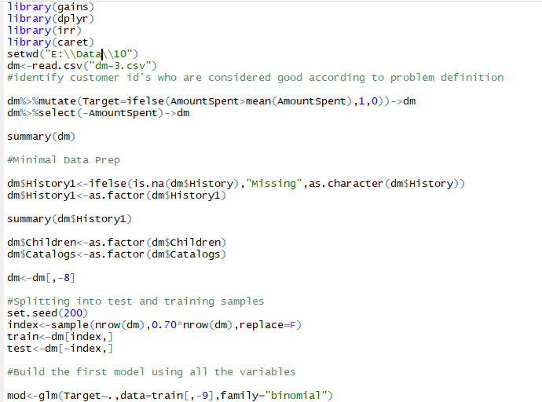
Logistic model building

Slide 10
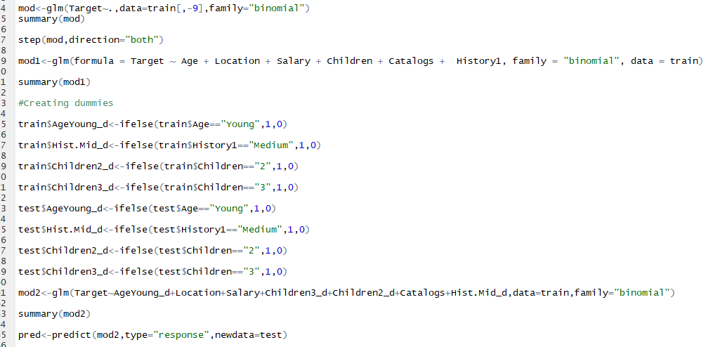

Slide 11
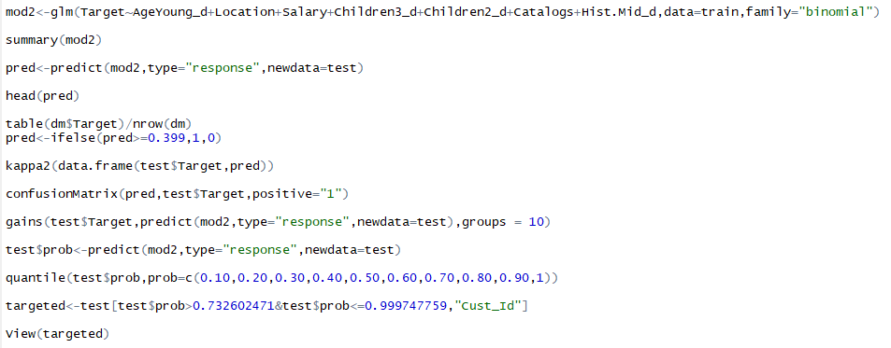

Slide 12
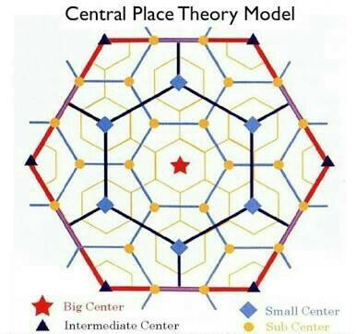
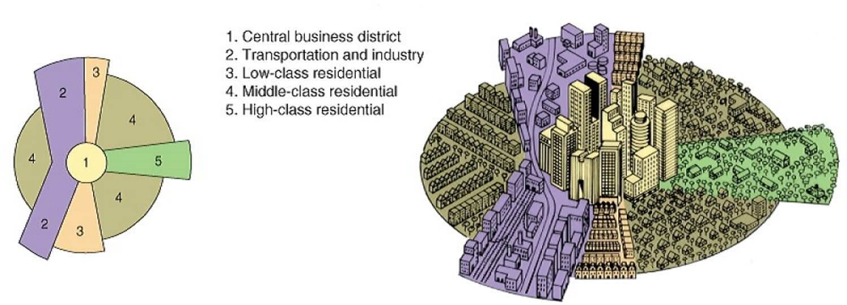
How to improve the model further

Slide 13
Longitude and latitude of the customer can be used identify in which cluster he belongs on that basis his income can be identified by using "central place theory” and sector theory. This will help model to bring better accuracy.

